Slide 1
Functions and Classes
ENGR 96A: Python and Machine Learning

Slide 2
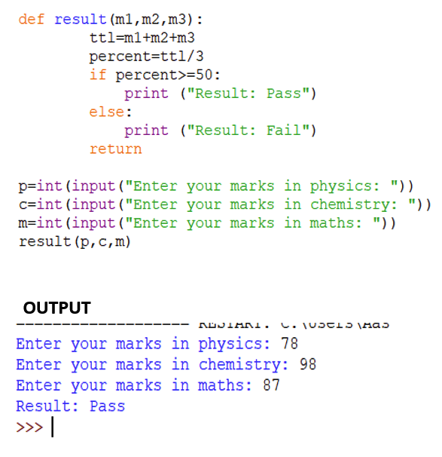
Functions
Functions are named pieces of code that do a specific task when they are called
Functions allow us to reuse code repeatedly instead of copying over and over
Additionally they allow us to use abstraction
Example: print() function as a steering wheel
Besides using the ones given in Python, we can write our own!
Notes:
We do not need to know the innards of how the print function works. We just have to know that what we enter inside the parentheses will get printed onto the screen. Essentially, we can treat it as a black box.

Slide 3
Writing your own functions
The basic syntax is as follows:
“def” keyword followed by function name and parameters
Parameters are the input to the function. You can have as many or as few inputs as you want.
Output is indicated with “return” followed by the output value
def functionName (parameter1, parameter2):
#Manipulate parameters here...
return returnValue

Slide 4
Basic example function
def addValues (value1, value2):
#Manipulate parameters here. In this example we add them.
totalSum = value1 + value2
return totalSum

Slide 5
A more complicated function
def addOrSub (value1, value2, switch):
if (switch == 0): #addition
result = value1 + value2
elif (switch == 1): #subtraction
result = value1 - value2
else: #neither
result = "Not addition or subtraction"
return result
#code to test the function
res1 = addOrSub(1, 2, 0)
res2 = addOrSub(1, 2, 2)
print(res1);
print(res2);
Note the control flow and use of commenting.

Slide 6
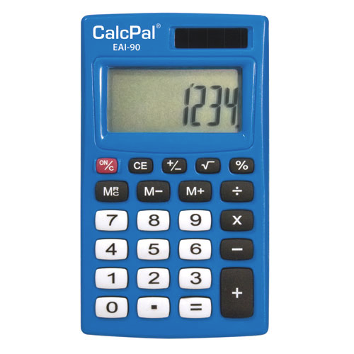
Challenge: Four Function Calculator
Using the function detailed on the previous slide as a guide, create a function that takes 3 inputs: two numbers to be manipulated and an operator to manipulate the two numbers with. Test to see if the function works with user input.

Slide 7
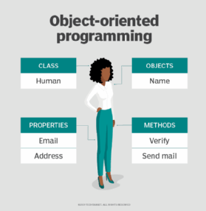
Classes
Variables + Functions → Classes
Set of code that represents an object
Example: Car class
Variables: make, model, year
Functions: drive(), park(), lock()
Instances of class
Example: individual cars
Focus on data and objects → Object Oriented Programming!

Slide 8
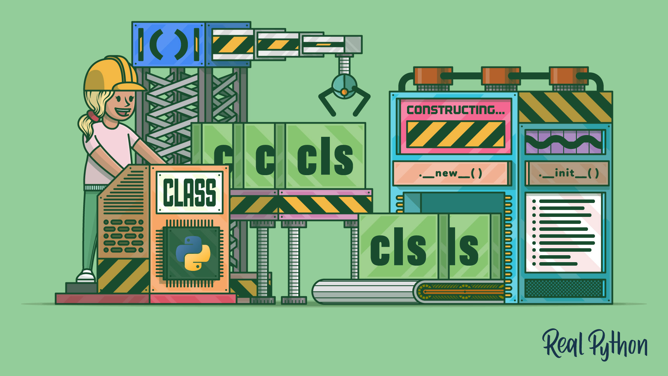
Parts of a class: Constructor
Special function that initializes a specific instance of a class
Allows us to customize our individual objects
Example:
2015 White Honda Civic vs. 2007 Gray Toyota Avalon
Creating an object
variableName = className(parameters)
Syntax:
def __init__(self, make, model):
self.make = make
self.model = model

Slide 9
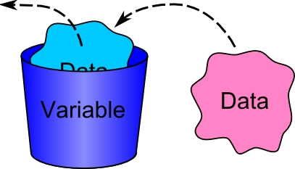
Parts of a class: Member Variables
Often defined within the constructor
Holds data about each specific instance for the class
Example: make, model, year, and color for a car
Are referred to within their class as self.variableName
Are referred to outside their class as instanceName.variableName

Slide 10
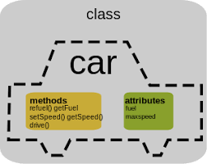
Parts of a Class: Member Functions
Defined within a class, these operate similar to other functions
Have access to the data contained within a class
Within their class, are referred to as self.functionName()
Outside of their class, are referred to as instanceName.functionName()

Slide 11
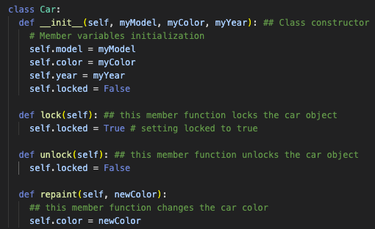
Creating your own classes
When creating classes, think about
What data does each instance of this class need to store?
What actions does each instance of this need to be able to perform?

Slide 12
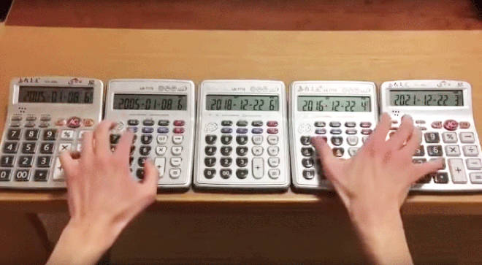
Challenge: Calculator Class
Create a calculator class that has a color, brand, and owner, in addition to performing +, -, *, and / functions. It should have a constructor, member variables, and member functions.

Slide 13
Summary
Functions
Classes
Parts of a class
Constructor
Member variables
Member functions

